Slide 1
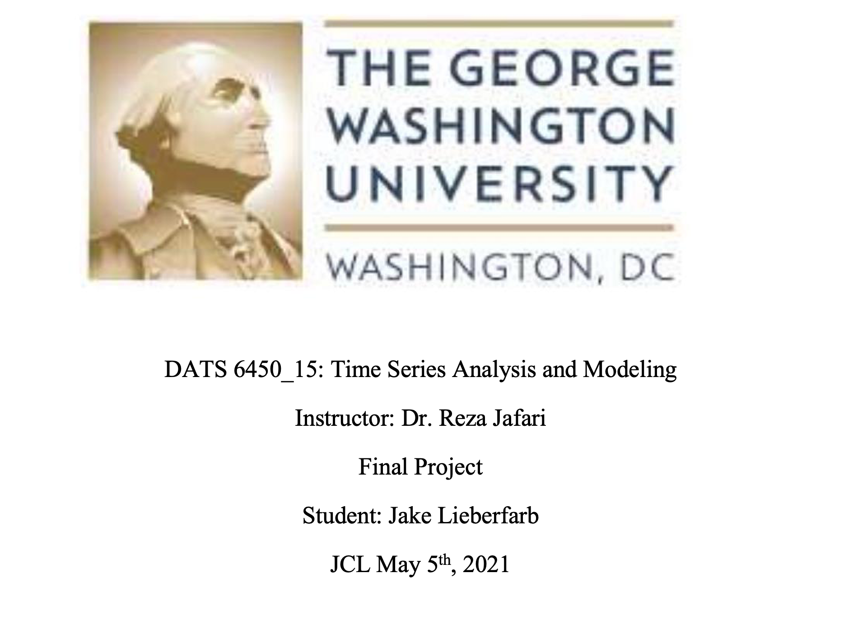

Slide 2
Table of contents
Descriptive Statistics
Seasonality
Holt-Winter model
Feature Selection and Backward Regression
Multiple Regression
ARMA
SARIMA
Base Models

Slide 3
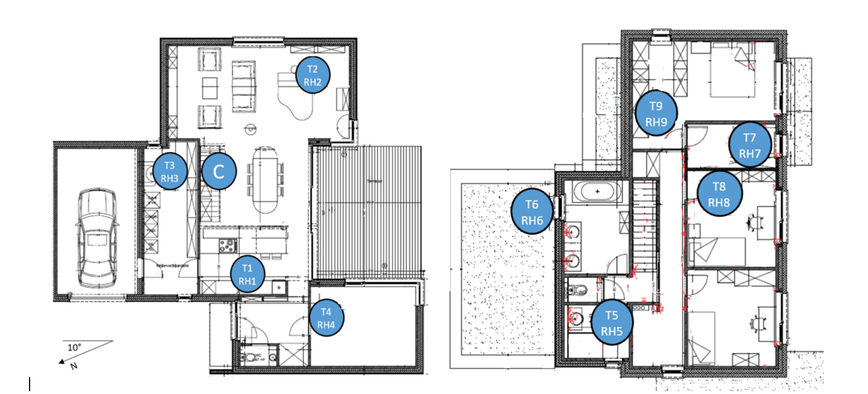
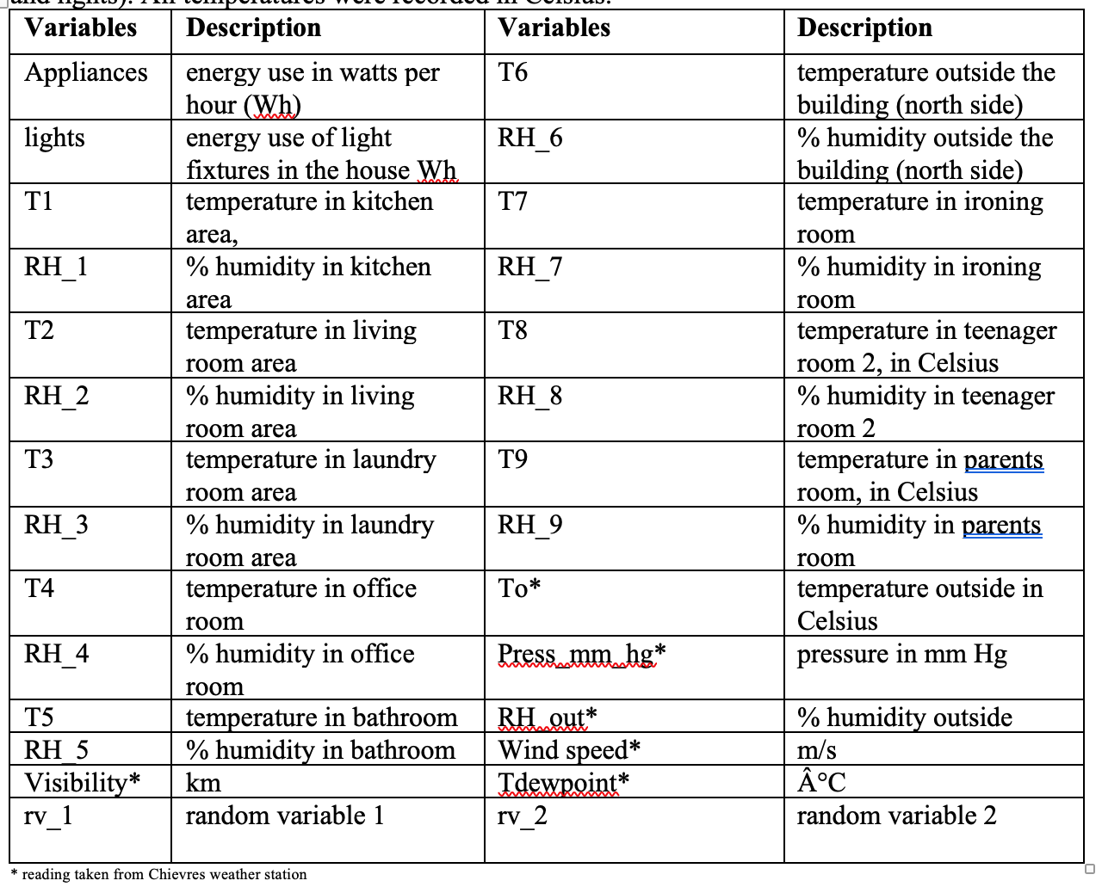
Descriptive Statistics (1 / 4)

Slide 4
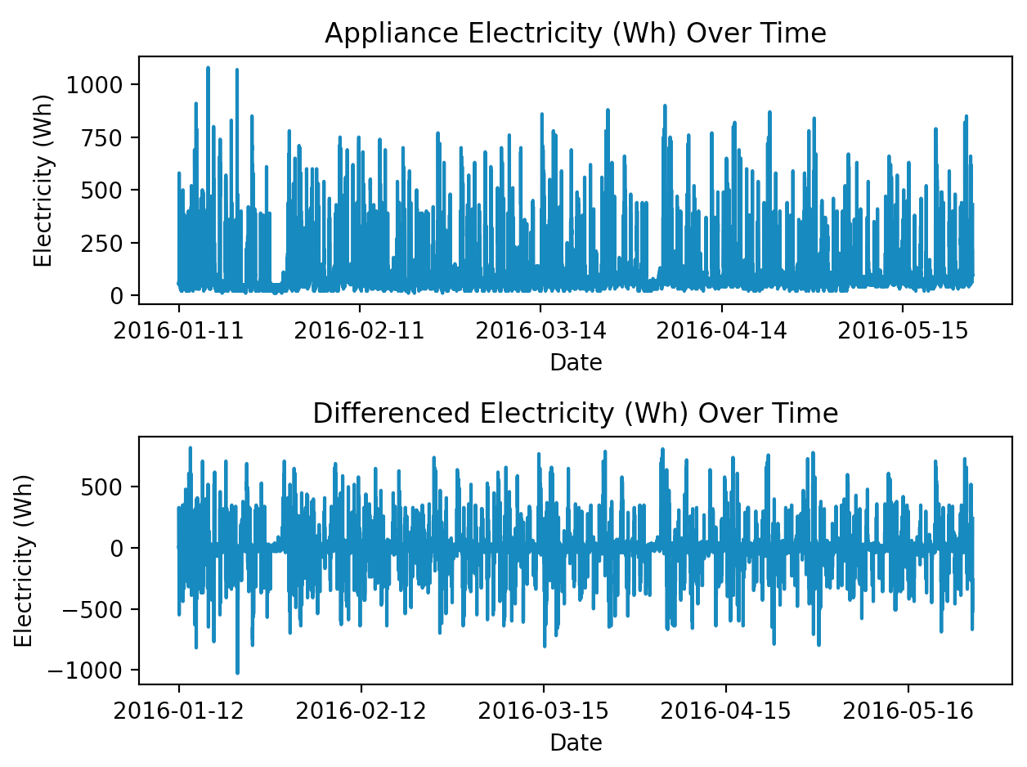
Descriptive Statistics (2 / 4)

Slide 5
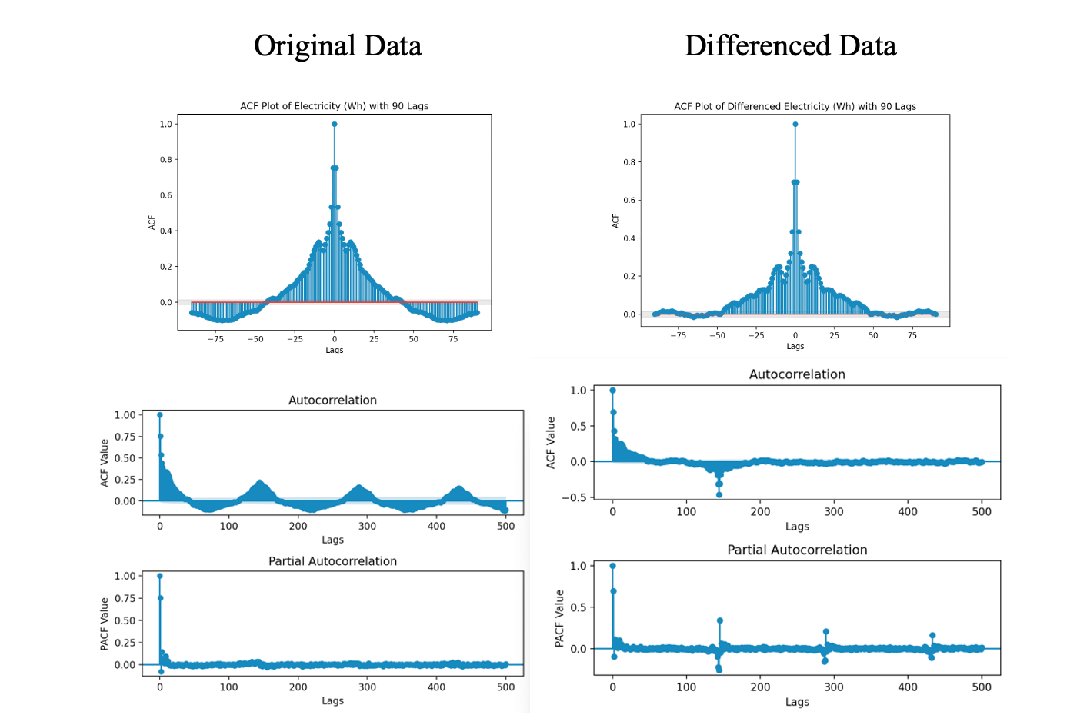
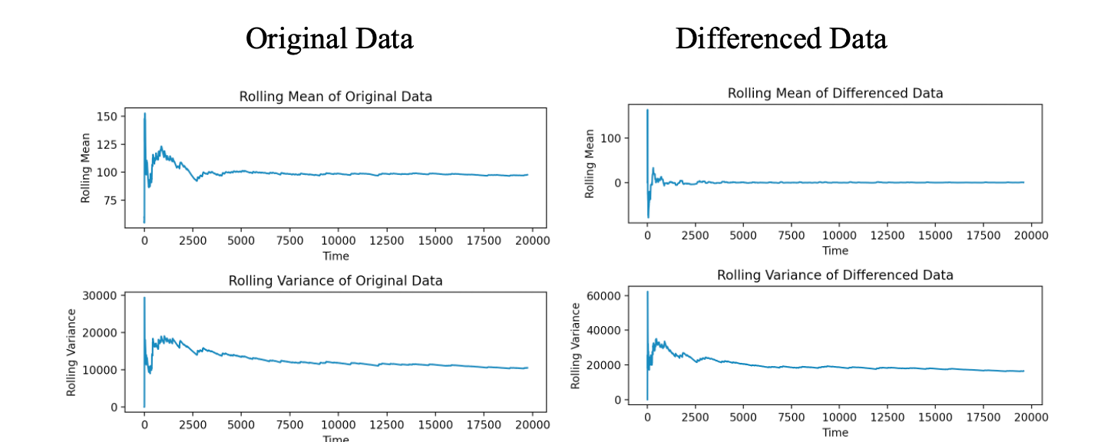
Descriptive Statistics (3 / 4)

Slide 6
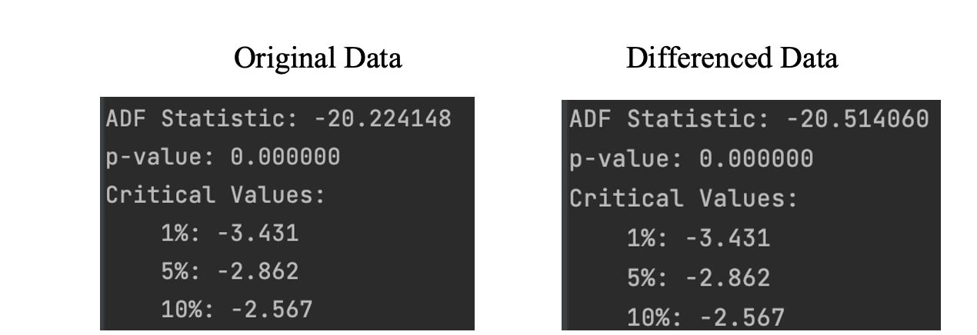
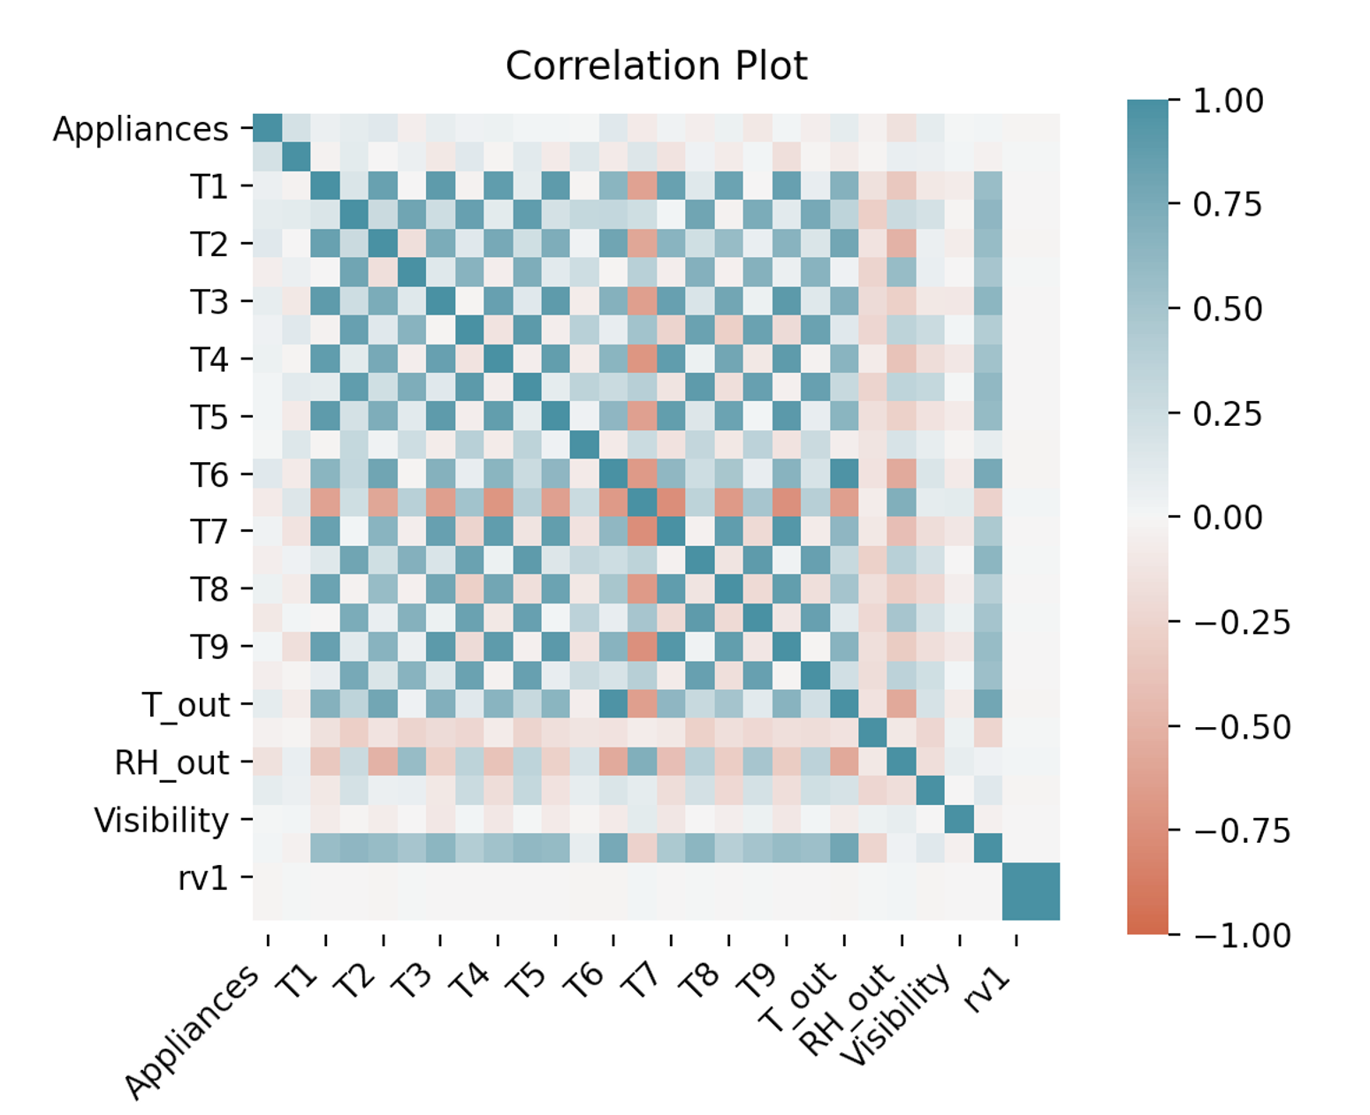
Descriptive Statistics (4 / 4)

Slide 7
Table of contents
Descriptive Statistics
Seasonality
Holt-Winter model
Feature Selection and Backward Regression
Multiple Regression
ARMA
SARIMA
Base Models

Slide 8
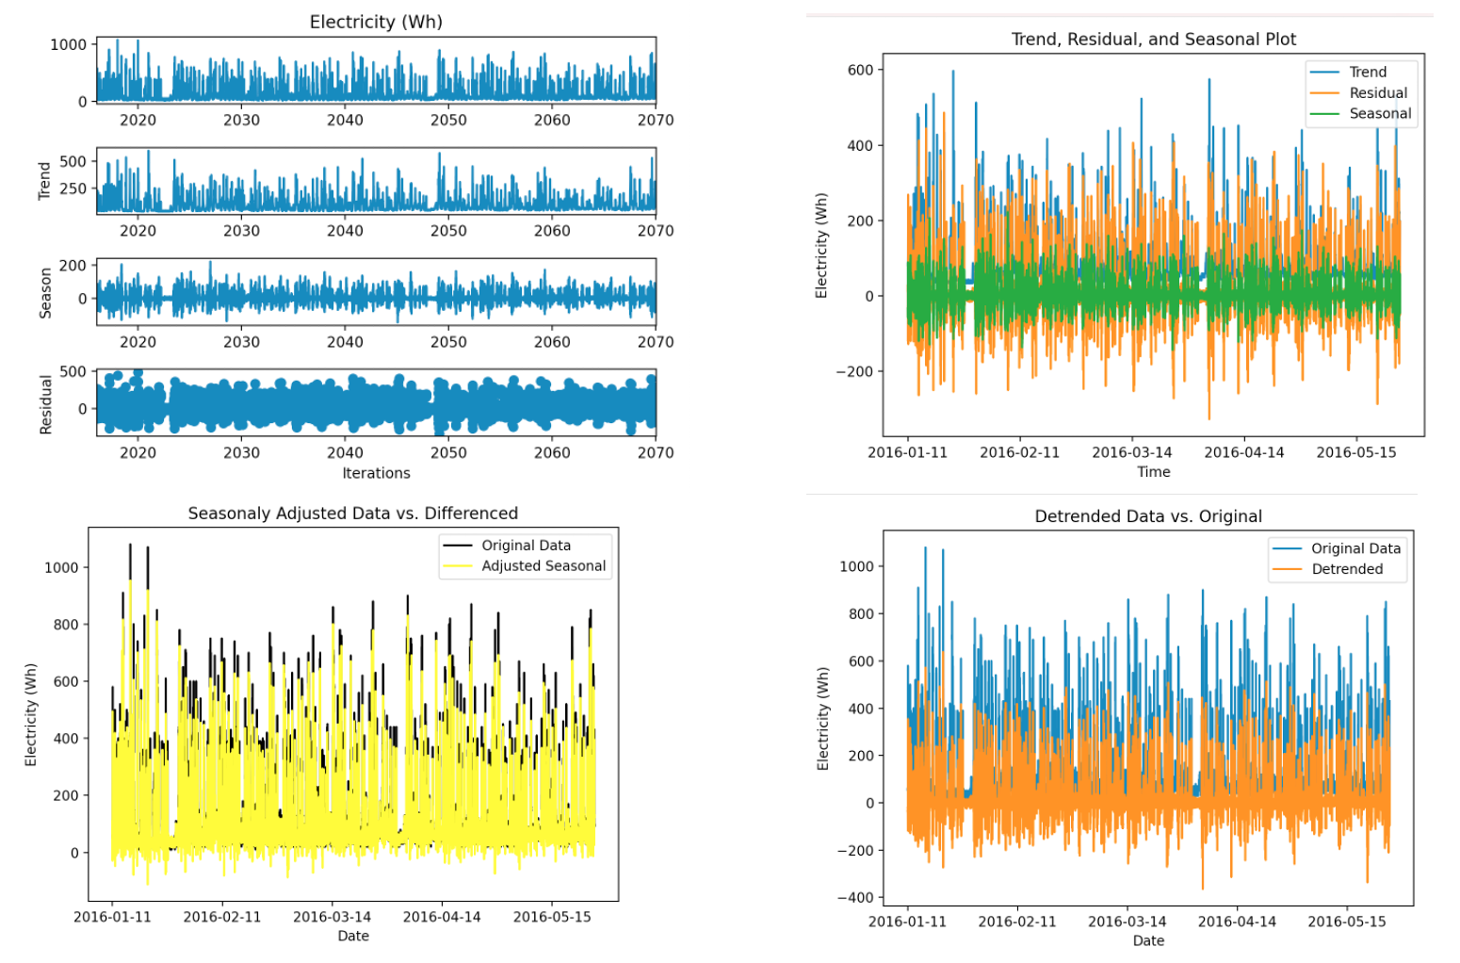
Seasonality
Statistic | Value
Strength of Trend | 0.728
Strength of Seasonality | 0.2883

Slide 9
Table of contents
Descriptive Statistics
Seasonality
Holt-Winter model
Feature Selection and Backward Regression
Multiple Regression
ARMA
SARIMA
Base Models

Slide 10
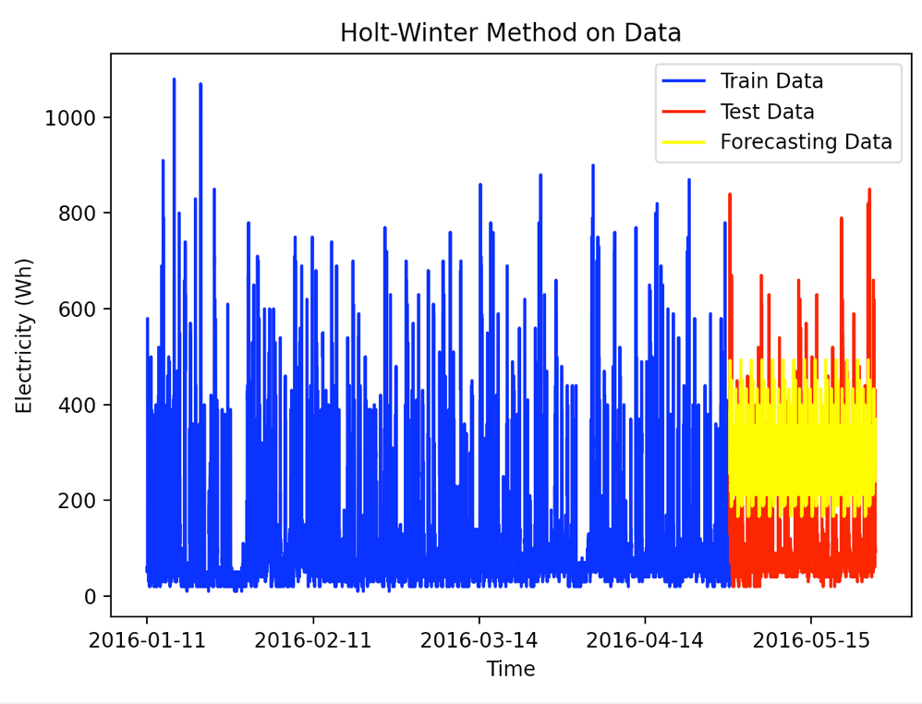
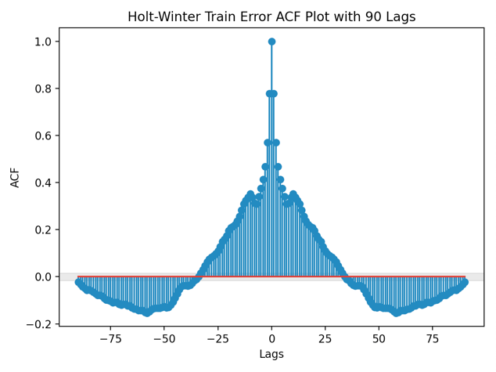
Holt-Winter model: Train (1 / 2)
Statistic | Values
MSE | 43496.2709
Ljung-Box Statistics | 23100.1654
Mean of model error | -172.7199
Variance of model error | 13664.0900
RMSE | 208.5576

Slide 11
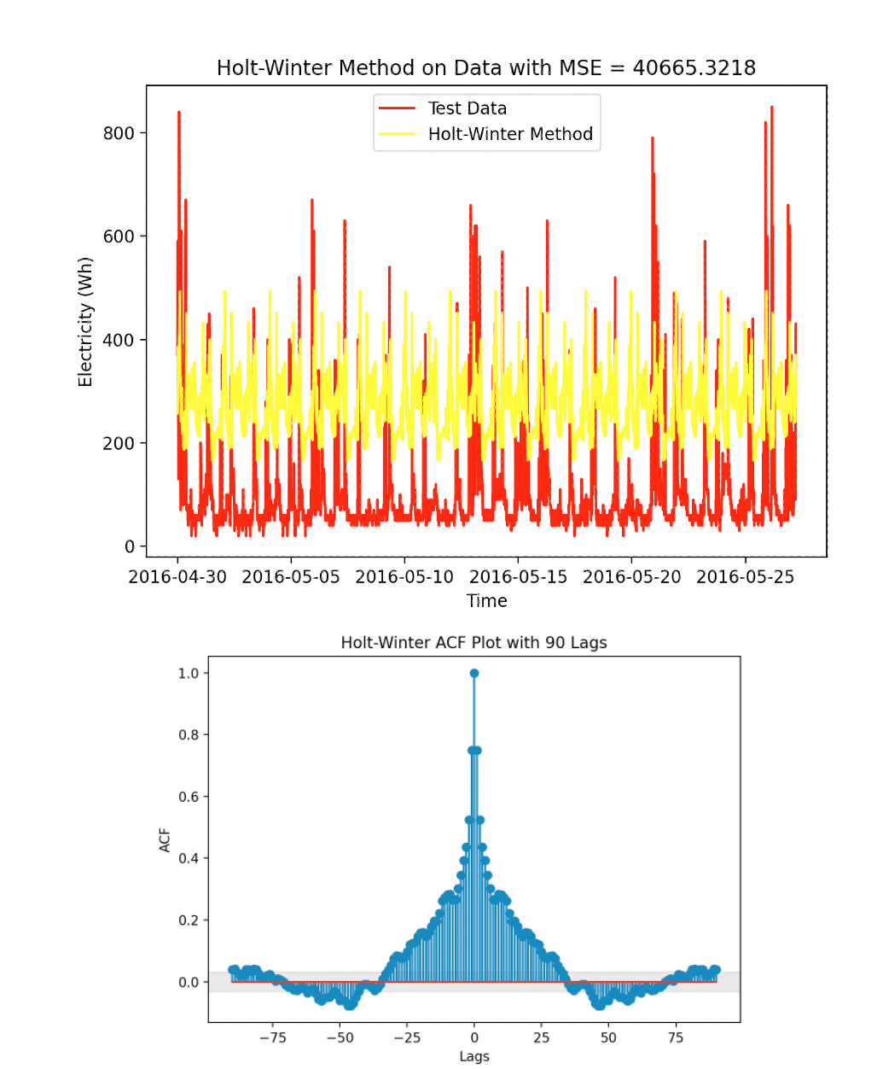
Holt-Winter Model: Test (2 / 2)
Statistic | Values
MSE | 40665.3218
Ljung-Box Statistics | 5138.065419
Mean of model error | -175.0463
Variance of model error | 10024.1039
RMSE | 201.6564

Slide 12
Table of contents
Descriptive Statistics
Seasonality
Holt-Winter model
Feature Selection and Backward Regression
Multiple Regression
ARMA
SARIMA
Base Models

Slide 13
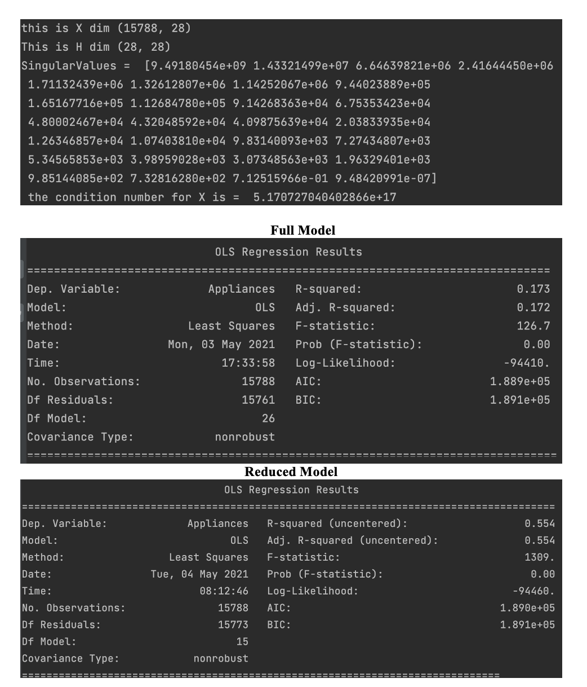
Feature Selection and Backward Regression

Slide 14
Table of contents
Descriptive Statistics
Seasonality
Holt-Winter model
Feature Selection and Backward Regression
Multiple Regression
ARMA
SARIMA
Base Models

Slide 15
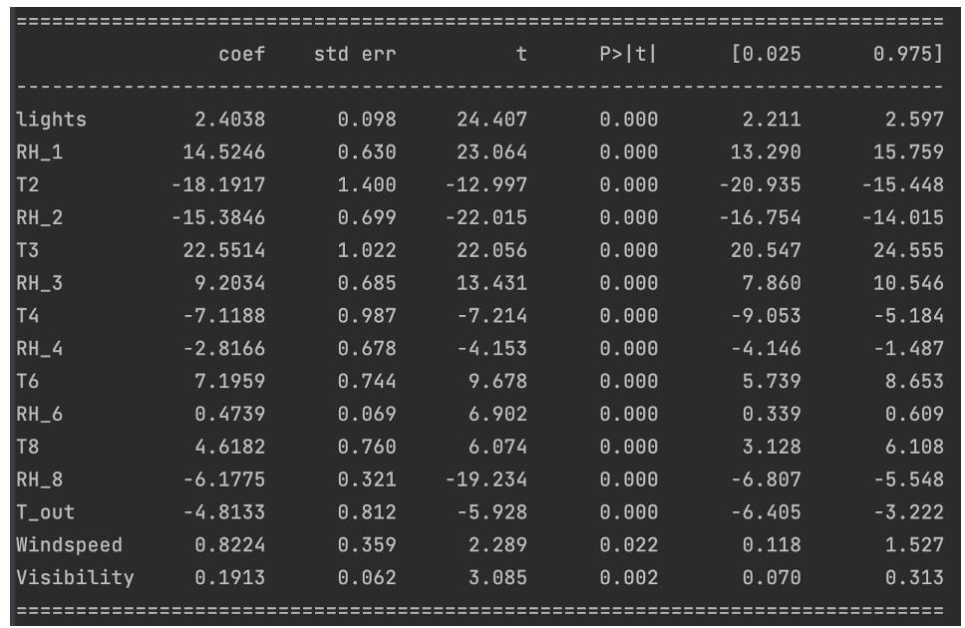
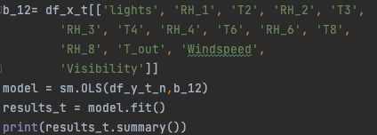
Multiple Linear Regression (1 / 4)

Slide 16
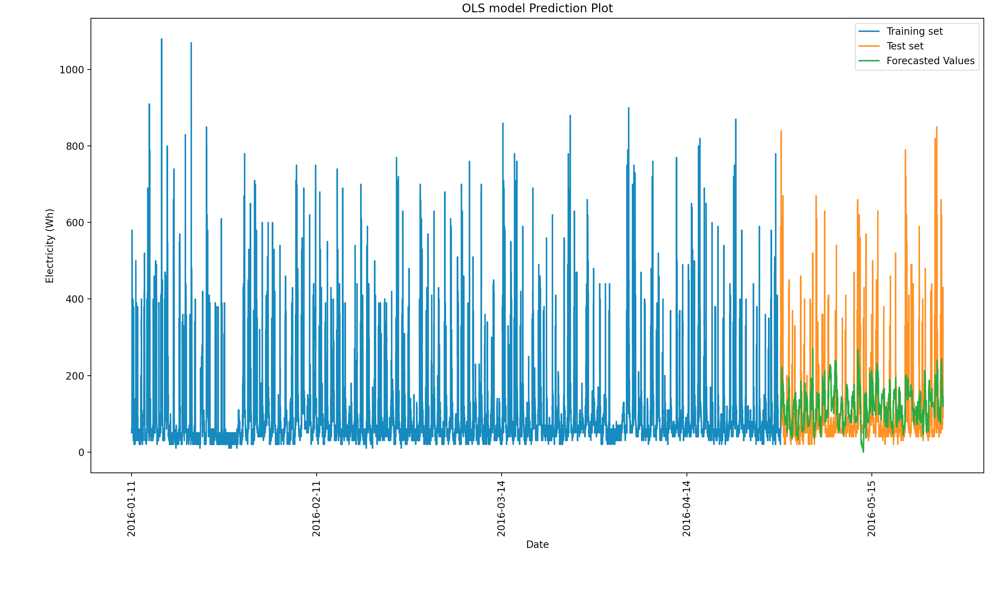
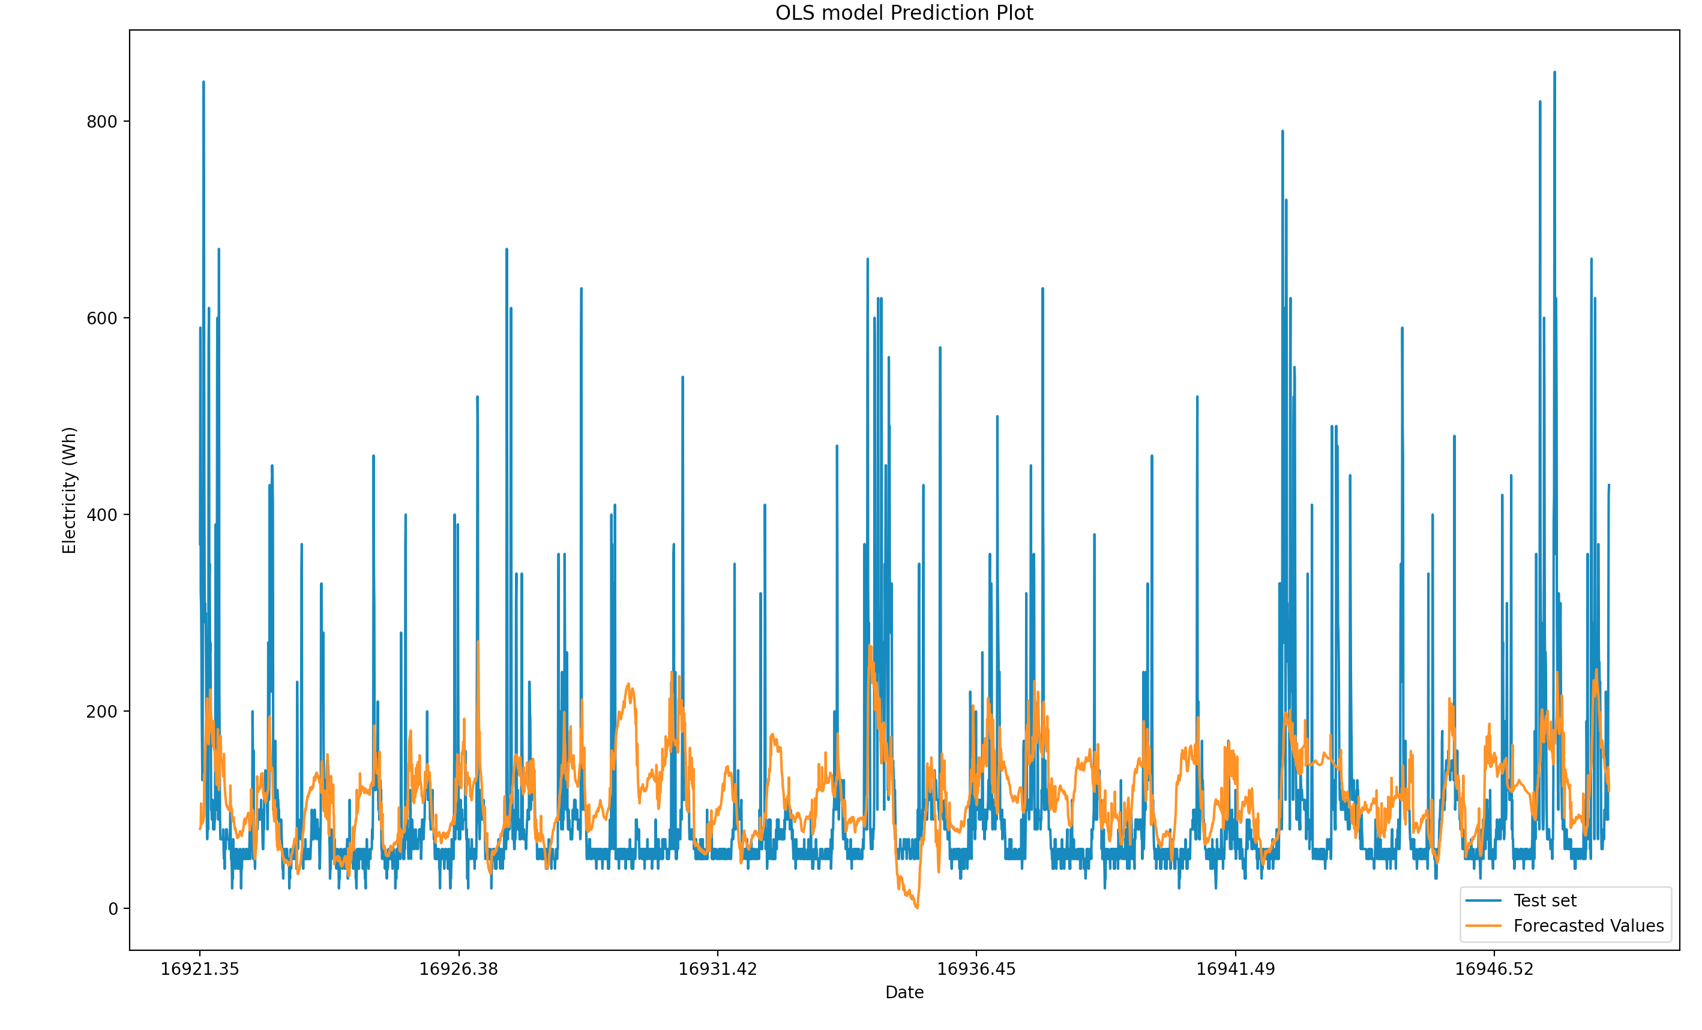
Multiple Linear Regression (2 / 4)

Slide 17
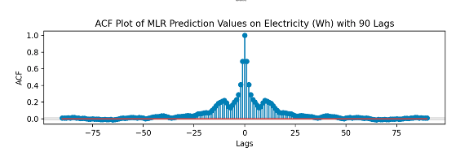
Multiple Linear Regression (3 / 3)
Train Data
Statistic | Values
MSE | 9211.4584
Ljung-Box Statistics | 12906.653091
Mean of model error | -0.0103
Variance of model error | 9211.4593
RMSE | 107.0686

Slide 18
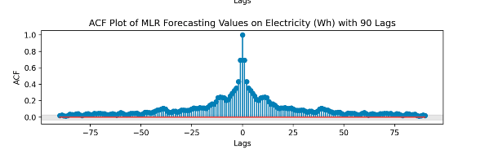
Multiple Linear Regression (3 / 4)
model checks
Statistic | values
R² | 0.554
Adjusted R² | 0.554
T test | All p-values <0.05
F- test | 1309
AIC, BIC | 1.890e+05
Test Data
Statistic | values
MSE | 7925.3884
Ljung-Box Statistic | 3890.720017
Mean of error | -17.6336
Variance of error | 7614.4434
RMSE | 121.6338

Slide 19
Table of contents
Descriptive Statistics
Seasonality
Holt-Winter model
Feature Selection and Backward Regression
Multiple Regression
ARMA
SARIMA
Base Models

Slide 20
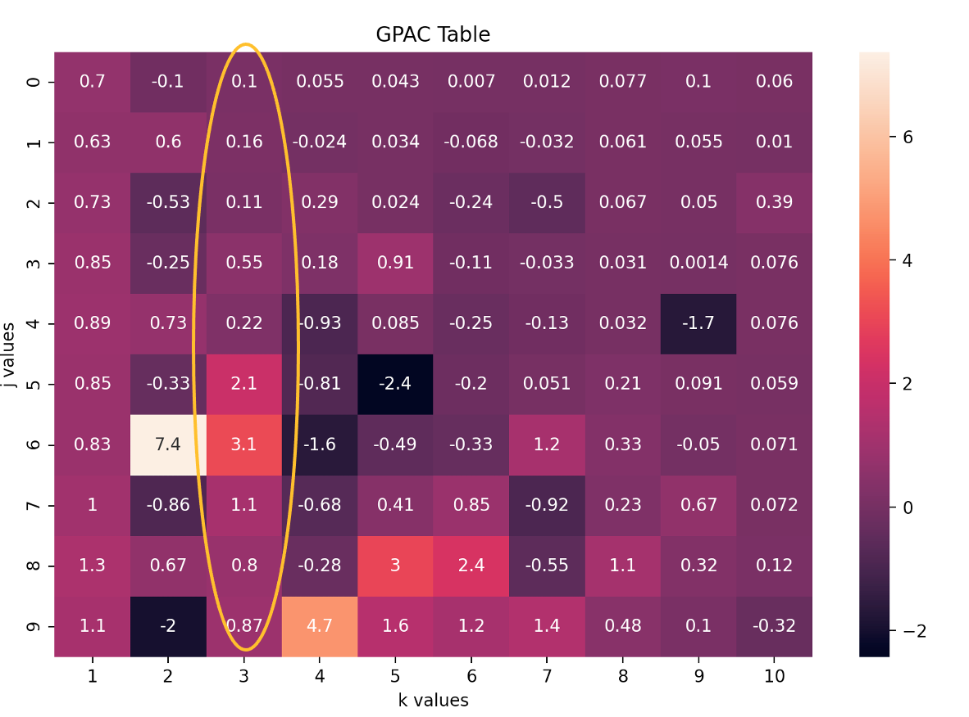
ARMA (1 /10)

Slide 21
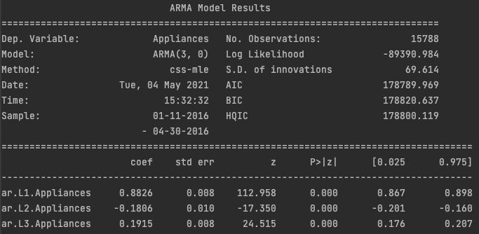
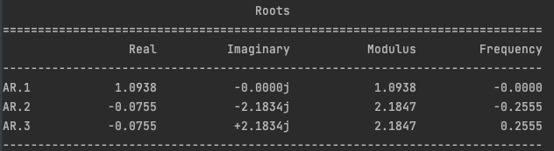
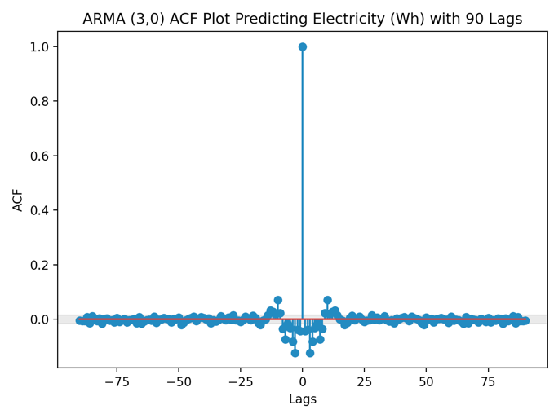
ARMA: ARMA(3,0) ( 2 / 7)
Train Data
Statistic | Values
MSE | 4846.3313
Ljung-Box Statistics | 414.214595
Mean of model error | 10.4497
Variance of model error | 4737.1346
RMSE | 69.6156

Slide 22
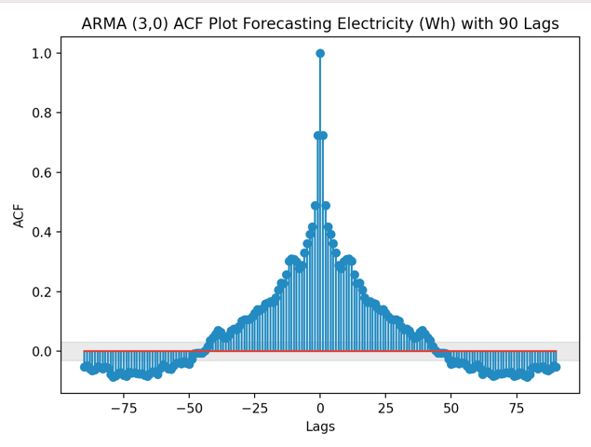
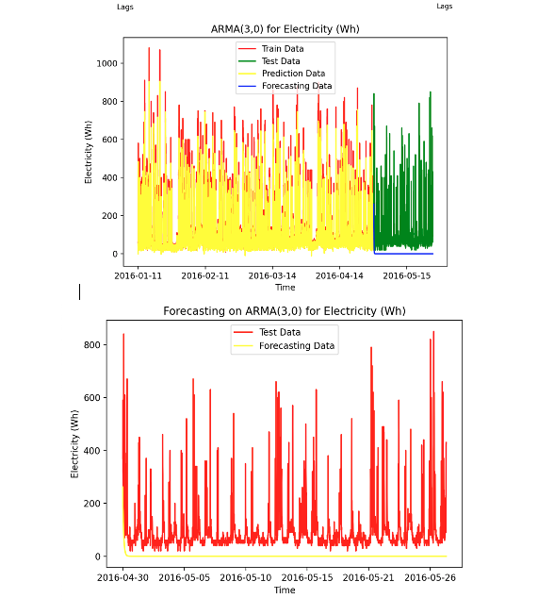
ARMA: ARMA(3,0) (3 / 7)
Test Data
Statistic | Values
MSE | 17223.5194
Ljung-Box Statistics | 4824.9665
Mean of model error | 95.7142
Variance of model error | 8062.3070
RMSE | 131.2384

Slide 23
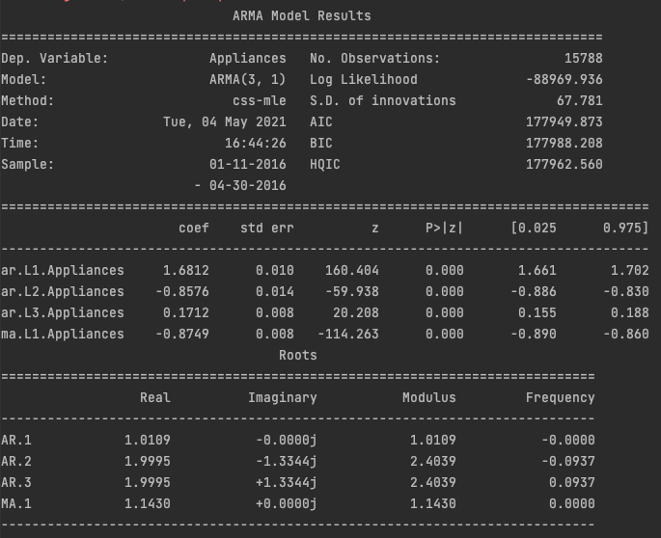
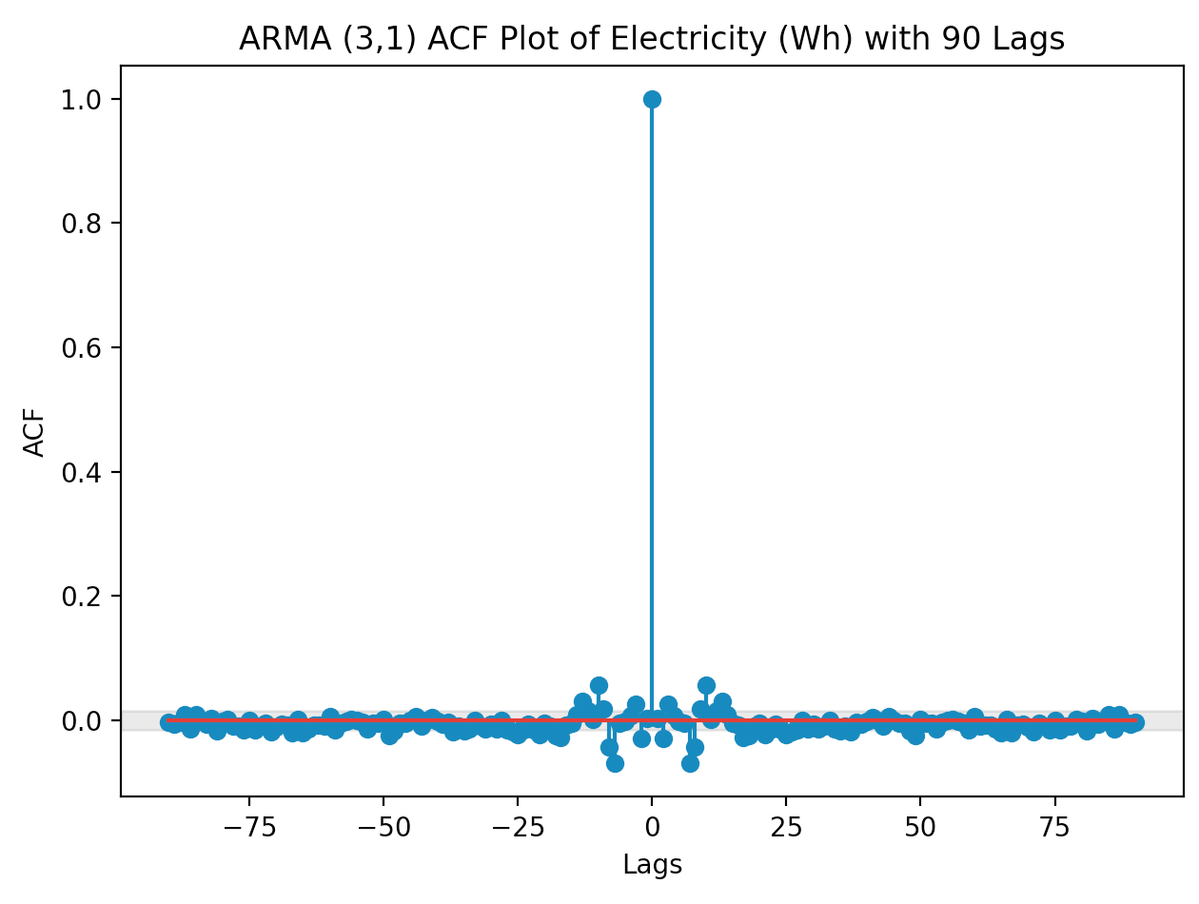
ARMA: ARMA(3,1) (4 / 7)
Train Data
Statistic | Values
MSE | 4594.581
Ljung-Box Statistics | 24.179986
Mean of model error | 5.09056
Variance of model error | 4577.8491
RMSE | 67.7833

Slide 24
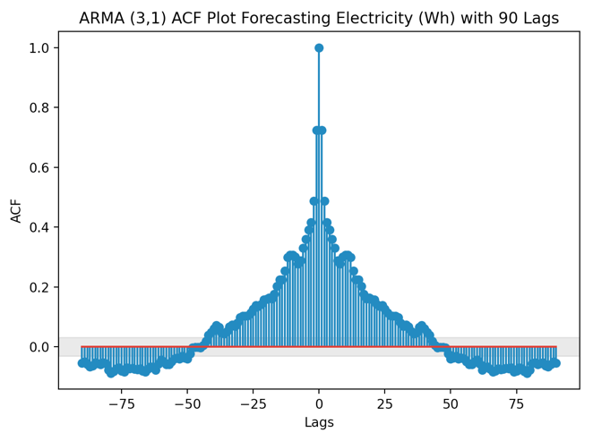
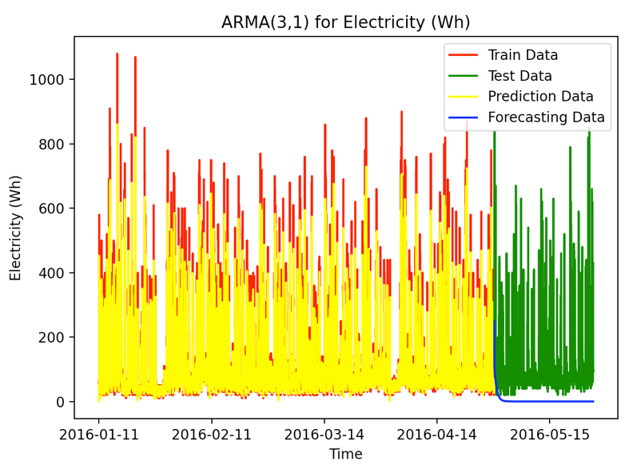
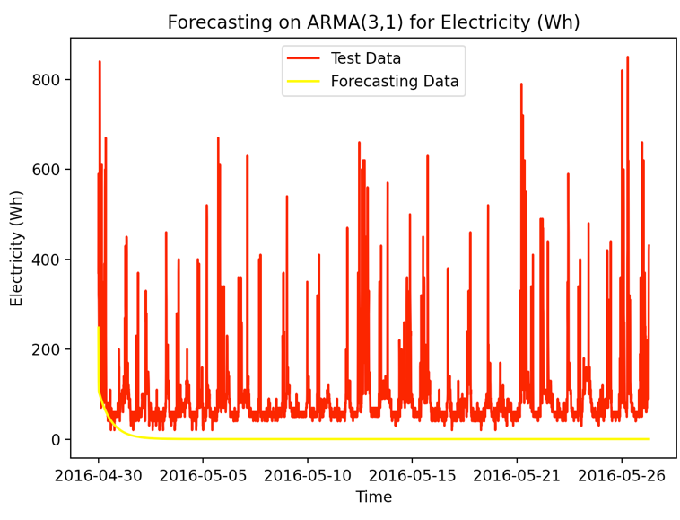
ARMA ARMA(3,1) (5 / 7)
Test Data
Statistic | Values
MSE | 16830.2026
Ljung-Box Statistics | 4809.263056
Mean of model error | 93.7375
Variance of model error | 8043.466
RMSE | 129.7313

Slide 25
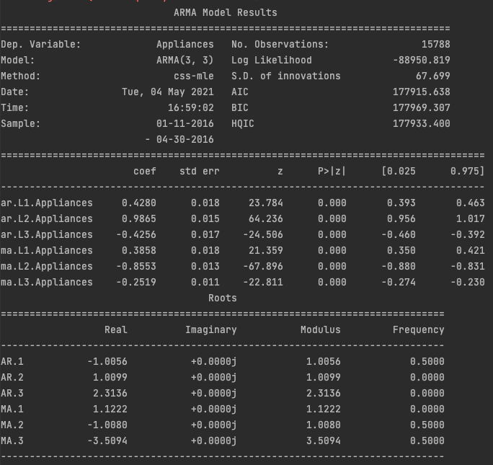
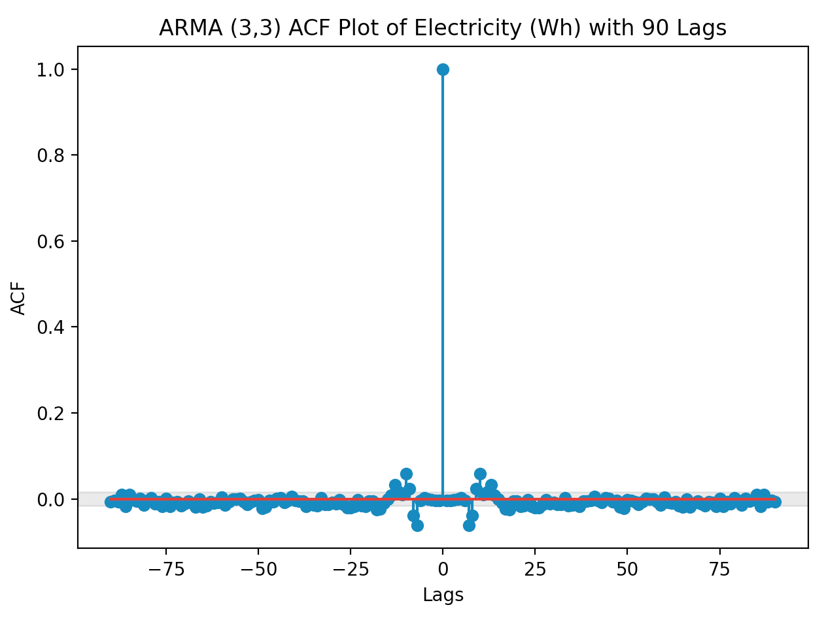
ARMA ARMA(3,3) (6 / 7)
Train Data
Statistic | Values
MSE | 4583.4875
Ljung-Box Statistics | 0.637048
Mean of model error | 3.9264
Variance of model error | 4568.0706
RMSE | 67.70146

Slide 26
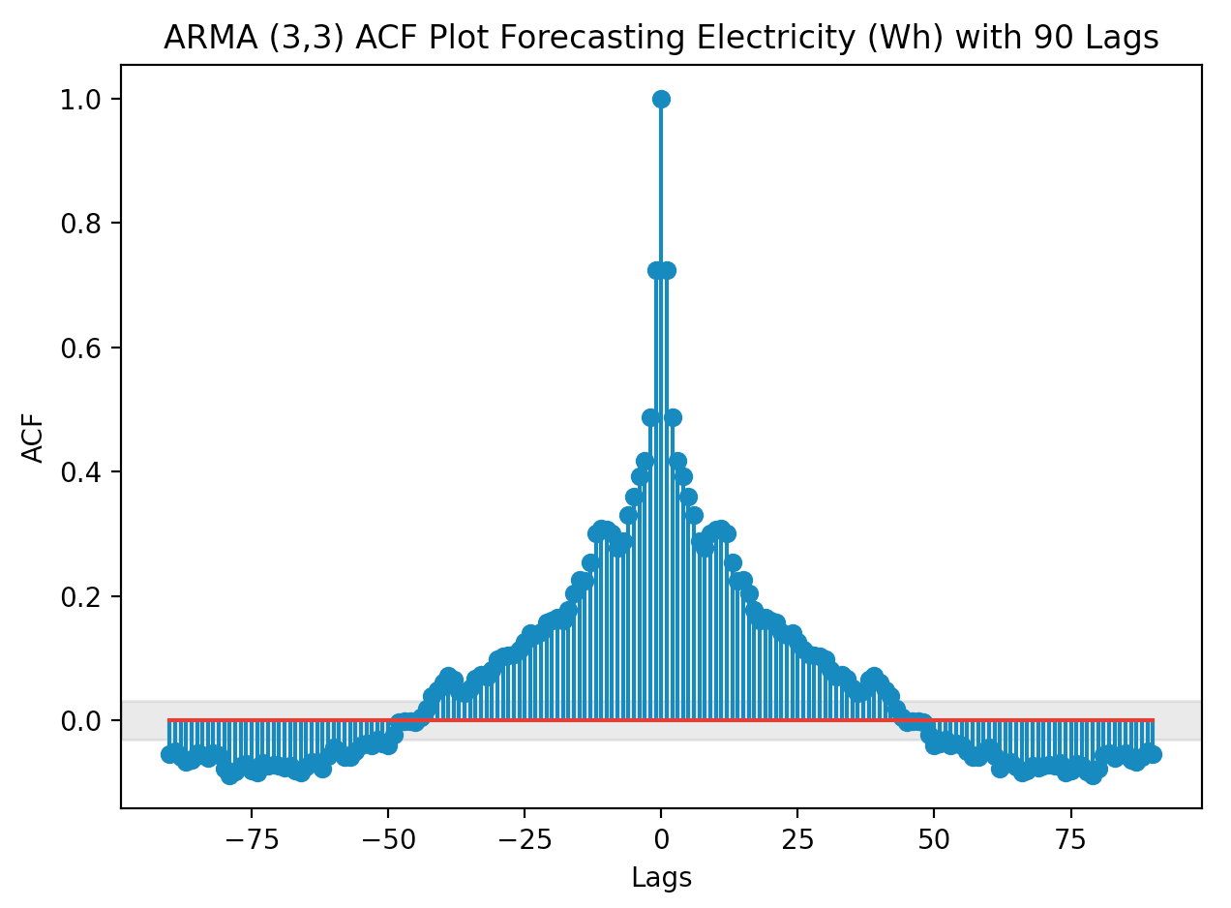
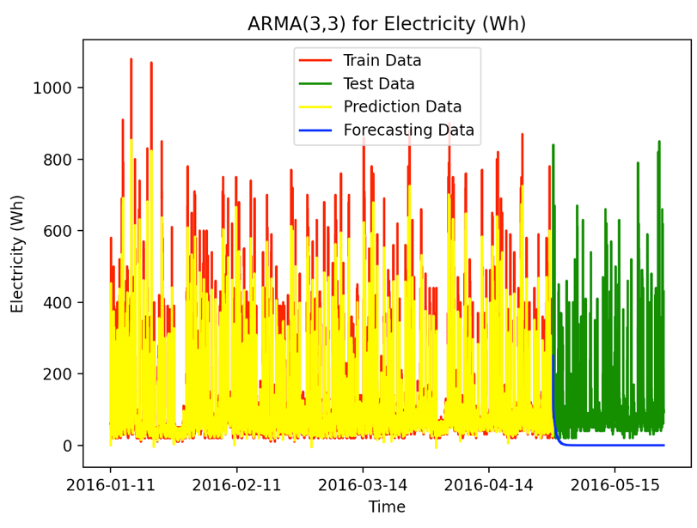
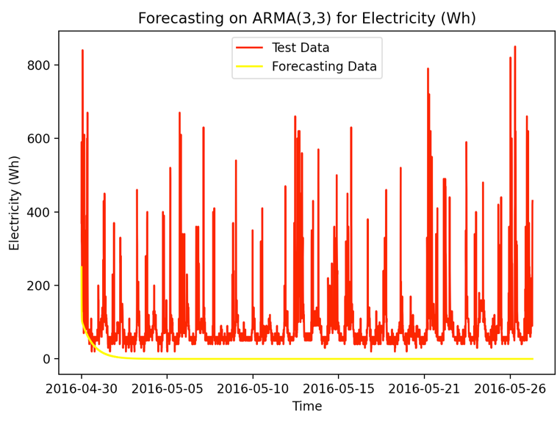
ARMA: ARMA(3,3) (7 / 7)
Test Data
Statistic | Values
MSE | 16809.65143
Ljung-Box Statistics | 4820.005256
Mean of model error | 93.56716
Variance of model error | 8054.8379
RMSE | 129.6503

Slide 27
Table of contents
Descriptive Statistics
Seasonality
Holt-Winter model
Feature Selection and Backward Regression
Multiple Regression
ARMA
SARIMA
Base Models

Slide 28
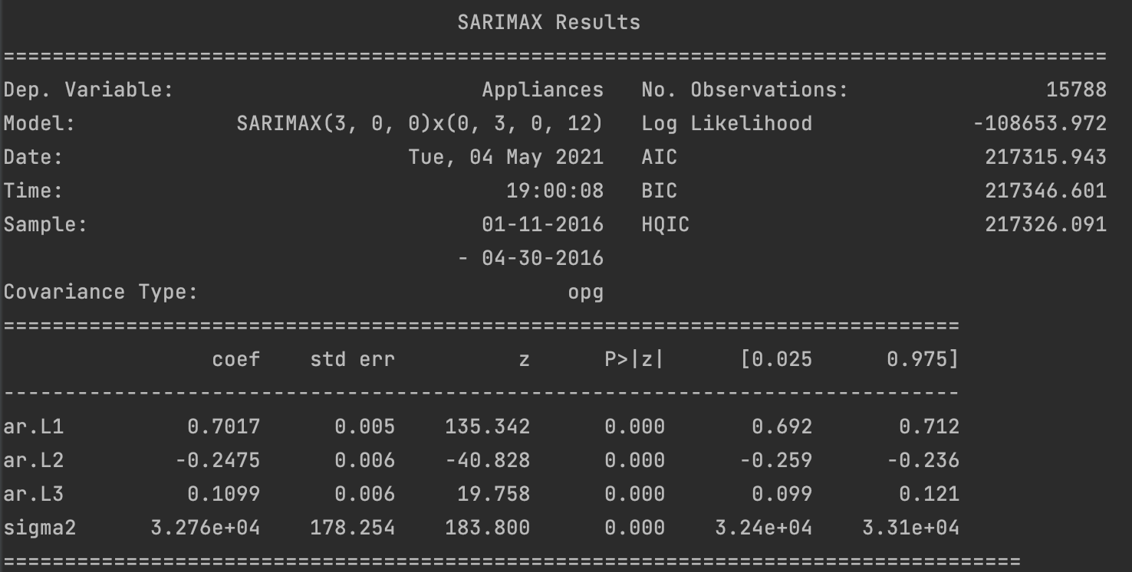
SARIMA: ARIMA(3,0,0)x(0,3,0,12) ( 1 / 3)

Slide 29
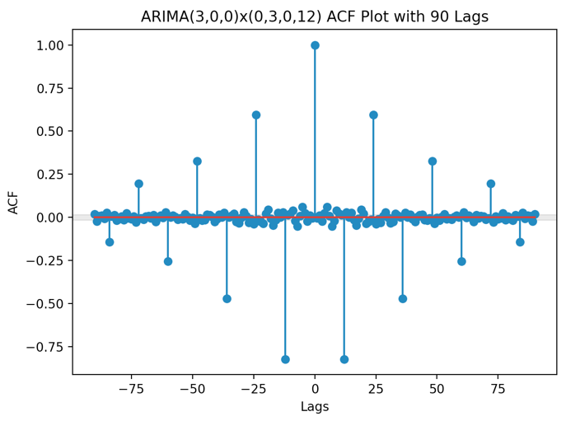
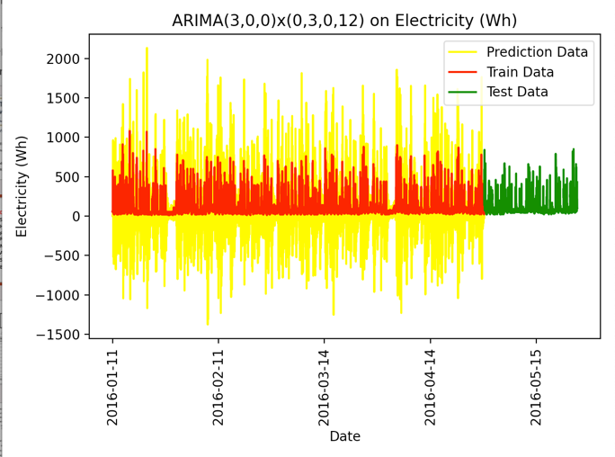
SARIMA ARIMA(3,0,0)x(0,3,0,12) ( 2 / 3)
Train Data
Statistic | Values
MSE | 57571.3242
Ljung-Box Statistics | 78.976724
Mean of model error | 0.04235
Variance of model error | 57571.3224
RMSE | 239.9403

Slide 30
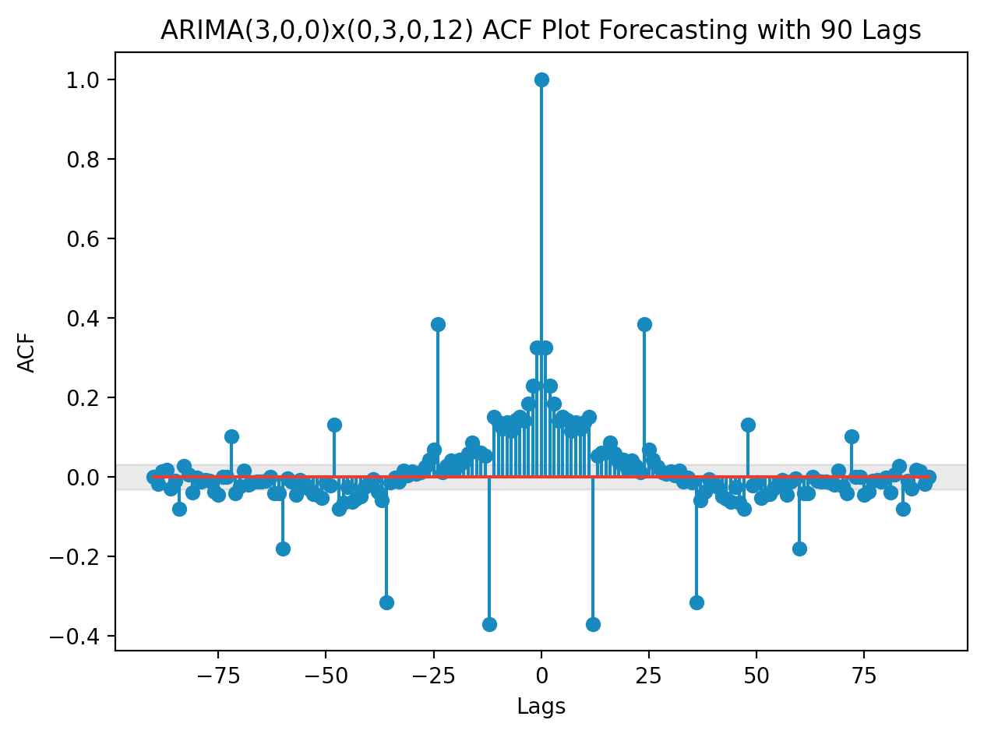
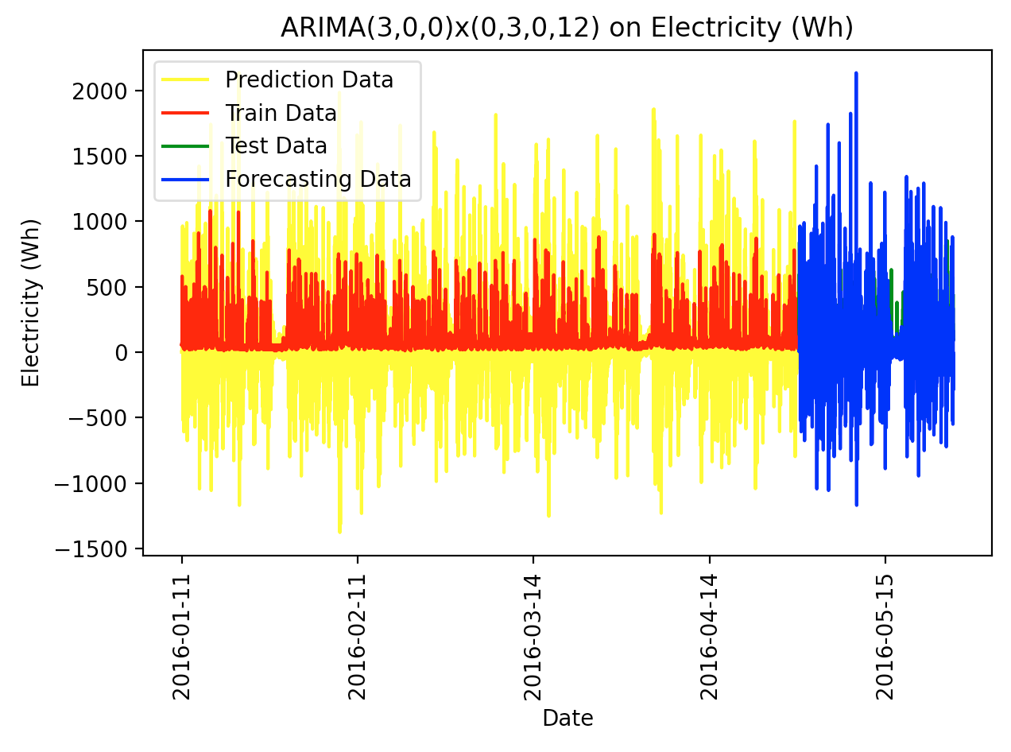
SARIMA ARIMA(3,0,0)x(0,3,0,12) ( 3 / 3)
Test Data
Statistic | Values
MSE | 75328.2380
Ljung-Box Statistics | 923.1114
Mean of model error | -0.7965
Variance of model error | 75327.6037
RMSE | 274.4599

Slide 31
Table of contents
Descriptive Statistics
Seasonality
Holt-Winter model
Feature Selection and Backward Regression
Multiple Regression
ARMA
SARIMA
Base Models

Slide 32
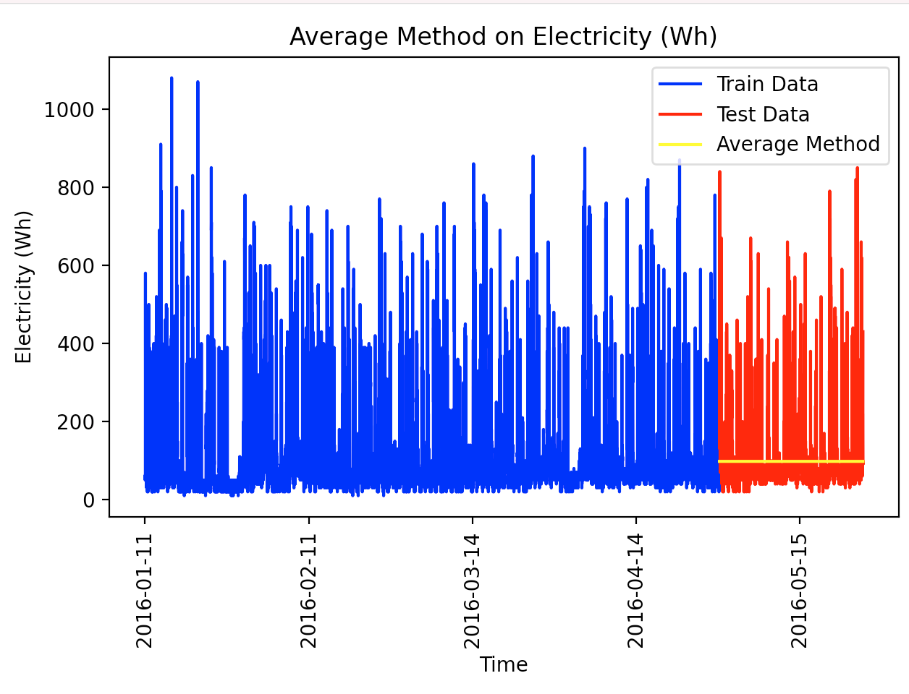
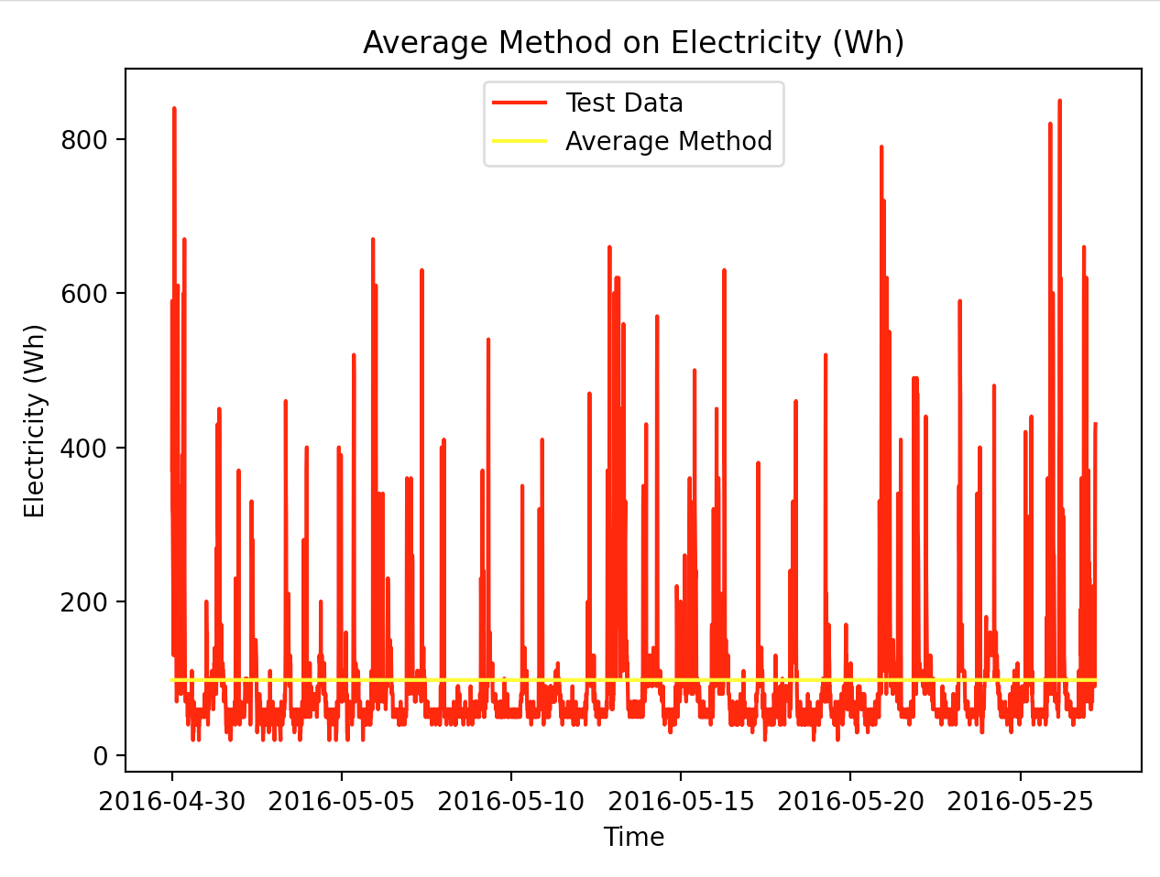
Base models: Average Method (1 / 8)

Slide 33

Base models: Average Method (2 / 8)
Test Data
Statistic | Values
MSE | 8290.728
Ljung-Box Statistics | 5014.178759
Mean of model error | -1.6475
Variance of model error | 8288.01394
RMSE | 91.0534

Slide 34
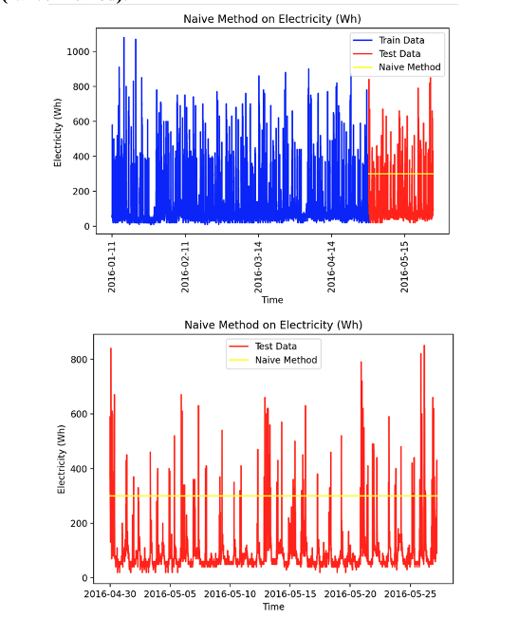
Base models: Naive Method (3 / 8)

Slide 35

Base models: Naive Method (4 / 8)
Test Data
Statistic | Values
MSE | 49750.342
Ljung-Box Statistics | 5014.178759
Mean of model error | -203.6230
Variance of model error | 8288.0139
RMSE | 233.0478

Slide 36
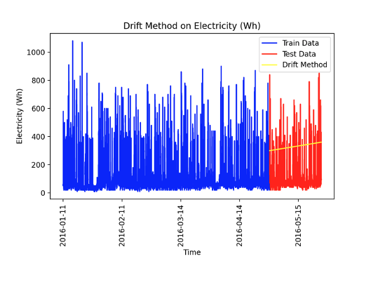
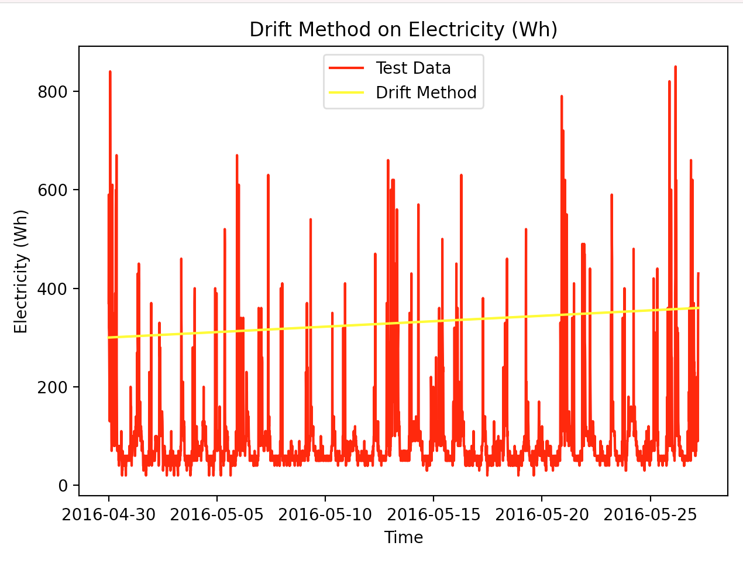
Base models: Drift Method (5 / 8)

Slide 37
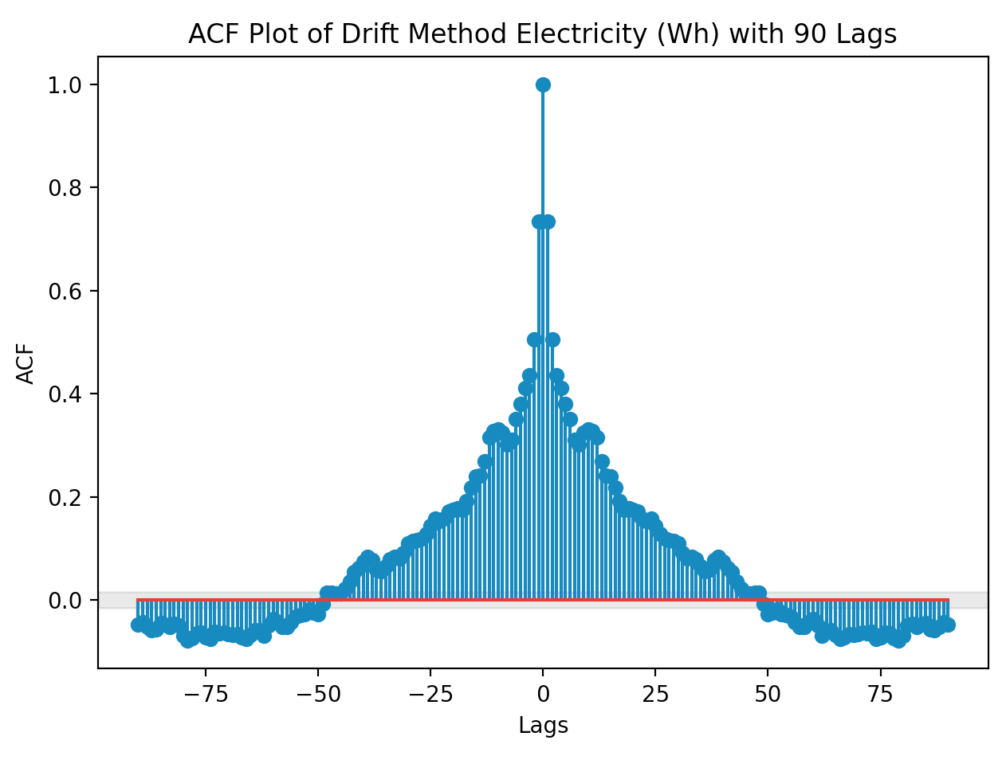
Base models: Drift Method (6 / 8)
Test Data
Statistic | Values
MSE | 62980.3347
Ljung-Box Statistics | 5129.25267
Mean of model error | -233.6325
Variance of model error | 8396.1867
RMSE | 250.9588

Slide 38
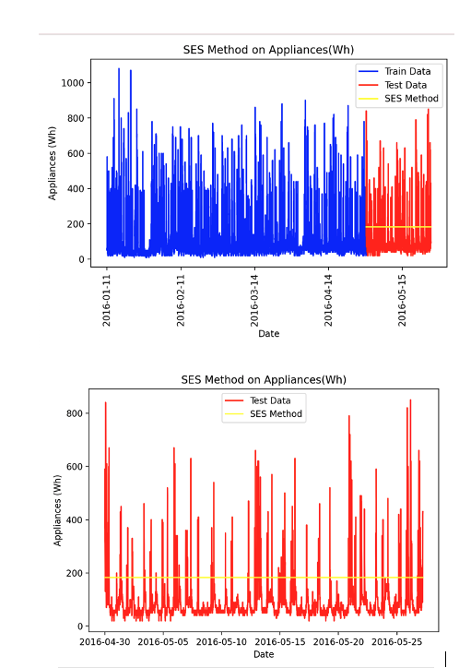
Base models: SES Method (7 / 8)

Slide 39

Base models: SES Method (8 / 8)
Test Data
Statistic | Values
MSE | 15784.7008
Ljung-Box Statistics | 5014.187859
Mean of model error | -86.5834
Variance of model error | 8288.0139
RMSE | 125.6372

Slide 40
Conclusion on Testing Data
Model | MSE | Ljung-Box | Mean of Error | Variance of Error | RMSE
Holt-winter | 40665.3218 | 5138.065419 | --175.0463 | 100024.1039 | 201.6564
Linear Regression | 7925.3884 | 3890.720017 | -17.6336 | 7614.4431 | 121.6338
ARMA(3,0) | 17223.5195 | 4824.96647 | 95.7142 | 806.3070 | 131.2384
ARMA(3,1) | 16830.2027 | 4809.263056 | 93.7376 | 8043.4661 | `129.7313
ARMA(3,3) | 16809.65143 | 4820.00526 | 93.5672 | 8054.8379 | 129.6503
ARIMA(3,0,0)x(0,3,0,12) | 75328.2380 | 923.1114 | -.7965 | 75327.6037 | 274.3499
Average | 8290.728 | 5014.178759 | -1.6475 | 8288.0139 | 98.0244
Naive | 49750.342 | 5014.178759 | -203.6230 | 8288.0139 | 223.0478
Drift | 62980.3347 | 5129.25267 | -233.6325 | 8396.1867 | 250.9588
SES | 15784.7008 | 5014.187859 | -86.5834 | 8288.0139 | 125.6372

Slide 41
Take away and further research
The multiple Linear Regression was the best predictor of Appliance energy output.
More data should be explored in this analysis
Look into how many people were in the home at a given time to see if there is a connection between
Take another sample of 4.5 months and compare to this data
Conduct a similar survey on multiple different homes

Slide 42
References
Candanedo, L. M. (n.d.). LuisM78/Appliances-energy-prediction-data. GitHub. https://github.com/LuisM78/Appliances-energy-prediction-data.
Singh, A. (2019, May 18). Appliances_energy_prediction_LSTM_ARIMA_FBPROPHET. Retrieved April 5, 2021, from https://www.kaggle.com/adityasingh22/appliances-energy-prediction-lstm-arima-fbprophet

Slide 44
Take away and further research
The multiple Linear Regression was the best predictor of Appliance energy output.
More data should be explored in this analysis
Look into how many people were in the home at a given time to see if there is a connection between
Take another sample of 4.5 months and compare to this data
Conduct a similar survey on multiple different homes

